Slide 1

Object-Oriented Programming in JavaScript
Unlocking Robust and Scalable Code with OOPs Principles

Slide 2



CHAPTER 1: Understanding the Core
What is Object-Oriented Programming (OOP)?
Organised Codebase
Enhanced Modularity
Robust & Secure
OOP is a paradigm for structuring code using objects and classes, mirroring real-world entities and their interactions.
It helps break down complex systems into smaller, manageable units, improving code organization and readability.
Key principles make code reusable, secure, and easy to manage, reducing errors and facilitating collaboration.

Slide 3

Why Adopt OOPs in JavaScript Development?
Modular & Clean Code
OOP fosters a modular design, leading to highly organised and maintainable codebases.
Real-World Modeling
It allows developers to map real-world concepts directly into code, simplifying complex problem-solving.
Simplified Debugging & Scaling
The structured nature of OOP makes code easier to debug, test, and scale for larger applications.
Native JavaScript Support
JavaScript embraces OOPs through modern syntax like class, object, and extends keywords, making it intuitive.

Slide 4




CHAPTER 2: The Four Pillars
The Fundamental Pillars of OOPs
Encapsulation
Bundles data and methods, hiding internal state from outside access for security and control.
Abstraction
Presents only essential features, hiding complex implementation details from the user.
Inheritance
Enables new classes (child) to reuse properties and methods of existing classes (parent), promoting code reusability.
Polymorphism
Allows objects of different classes to be treated as objects of a common type, enabling a single interface for diverse functionalities.

Slide 5
Encapsulation & Abstraction in Action
Encapsulation Example
Abstraction Example
class User { constructor(name) { let _name = name; // Private-like variable this.getName = () => _name; // Public getter }}const user = new User("Hariom");console.log(user.getName()); // Access via getter// console.log(user._name); // Undefined, hidden
class Car { drive() { this.startEngine(); // Abstraction: internal console.log("Car is moving"); } startEngine() { console.log("Engine started"); }}const myCar = new Car();myCar.drive(); // User only sees 'drive()'
This code demonstrates encapsulation by hiding the _name variable within the User class, accessible only through the getName method.
Here, the drive() method abstracts the underlying startEngine() logic. The user only needs to call drive() without knowing its internal steps.

Slide 6
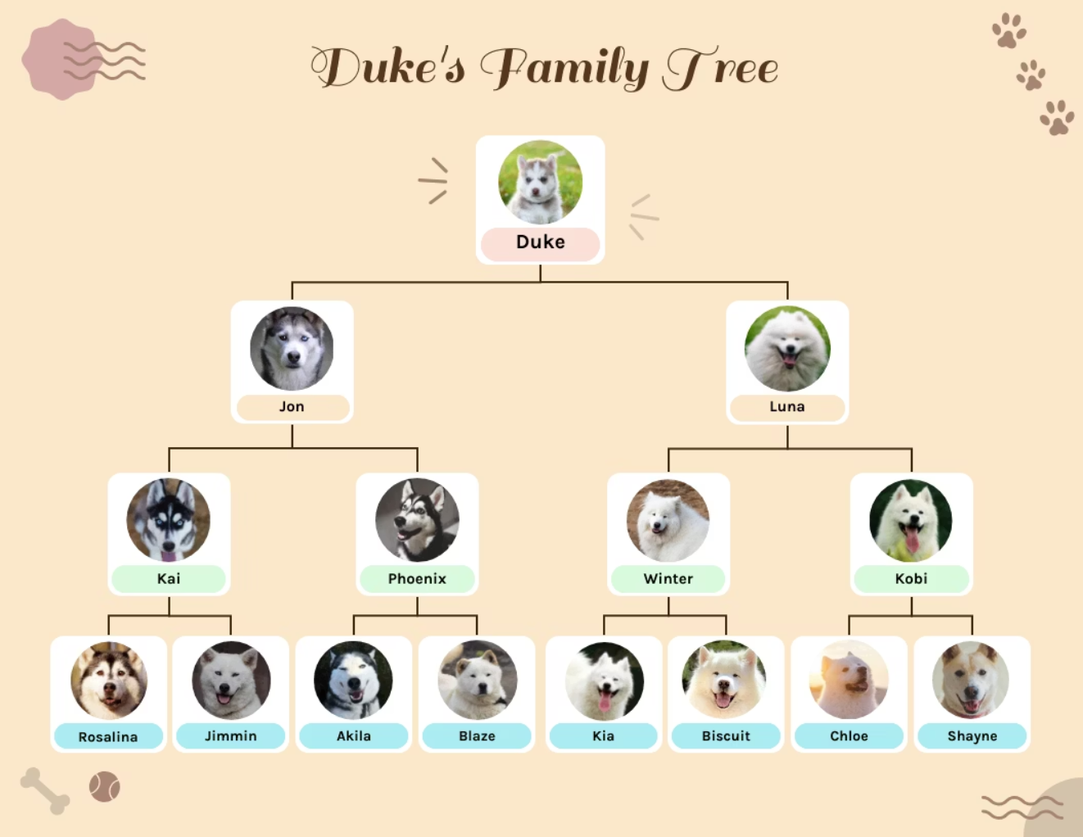
Inheritance: Building on Existing Foundations
class Animal { constructor(name) { this.name = name; } sound() { console.log(`${this.name} makes a generic sound.`); }}class Dog extends Animal { constructor(name, breed) { super(name); // Call parent constructor this.breed = breed; } sound() { // Override parent method console.log(`${this.name} (${this.breed}) barks loudly!`); } bark() { console.log("Woof woof!"); }}const myDog = new Dog("Buddy", "Golden Retriever");myDog.sound(); // Output: Buddy (Golden Retriever) barks loudly!myDog.bark(); // Output: Woof woof!
In this example, the Dog class inherits from the Animal class. It reuses the sound() method (and overrides it for specific behaviour) and adds its own unique bark() method.
This demonstrates how inheritance promotes code reusability and allows for a hierarchical relationship between classes.

Slide 7
Understanding Types of Inheritance in JavaScript
Single Inheritance
Multilevel Inheritance
Hierarchical Inheritance
A class inherits from only one parent class. (e.g., Dog extends Animal)
A class inherits from another class, which itself inherits from a third class. (e.g., Puppy extends Dog extends Animal)
Multiple classes inherit from a single parent class. (e.g., Cat extends Animal, Fish extends Animal)
Multiple Inheritance (Not Direct)
Hybrid Inheritance
JavaScript does not directly support inheriting from multiple classes. This is often achieved using mixins.
A combination of two or more types of inheritance, often involving mixins to simulate multiple inheritance patterns.

Slide 8

Polymorphism: Many Forms, One Interface
class Shape { draw() { console.log("Drawing a generic shape."); }}class Circle extends Shape { draw() { console.log("Drawing a circle."); }}class Rectangle extends Shape { draw() { console.log("Drawing a rectangle."); }}const shapes = [new Shape(), new Circle(), new Rectangle()];shapes.forEach(shape => shape.draw());// Output:// Drawing a generic shape.// Drawing a circle.// Drawing a rectangle.
This code illustrates polymorphism through method overriding. The draw() method behaves differently based on the object type (Shape, Circle, or Rectangle), despite being called using a common interface.
This flexibility allows for more adaptable and extensible code designs.

Slide 9

CHAPTER 3: Practical Implementation
Classes and Objects in JavaScript
class Student { constructor(name, studentId) { this.name = name; this.studentId = studentId; } showDetails() { console.log(`Name: ${this.name}, ID: ${this.studentId}`); } static generateId() { return Math.floor(Math.random() * 10000); }}// Creating objects (instances of the class)const student1 = new Student("Hariom", Student.generateId());const student2 = new Student("Priya", Student.generateId());student1.showDetails(); // Output: Name: Hariom, ID: [random_id]student2.showDetails(); // Output: Name: Priya, ID: [random_id]
In JavaScript, a class is a blueprint for creating objects (instances). The Student class defines properties (name, studentId) and methods (showDetails()).
Each const declaration (student1, student2) creates a new object based on this blueprint, demonstrating how classes are used to instantiate individual entities with shared characteristics and behaviours.

Slide 10

Key Takeaways: Mastering OOPs in JS
JavaScript fully supports OOPs principles through modern class syntax and object paradigms.
The four pillars—Encapsulation, Abstraction, Inheritance, and Polymorphism—are crucial for robust design.
OOP facilitates real-world modeling and promotes code reusability, leading to maintainable applications.
Hands-on practice with small examples is the most effective way to grasp these concepts deeply.
💡 Future-Proof Your Code
Embrace OOPs to build clean, scalable, and efficient applications that are easier to develop and maintain in the long run.

